Slide 1
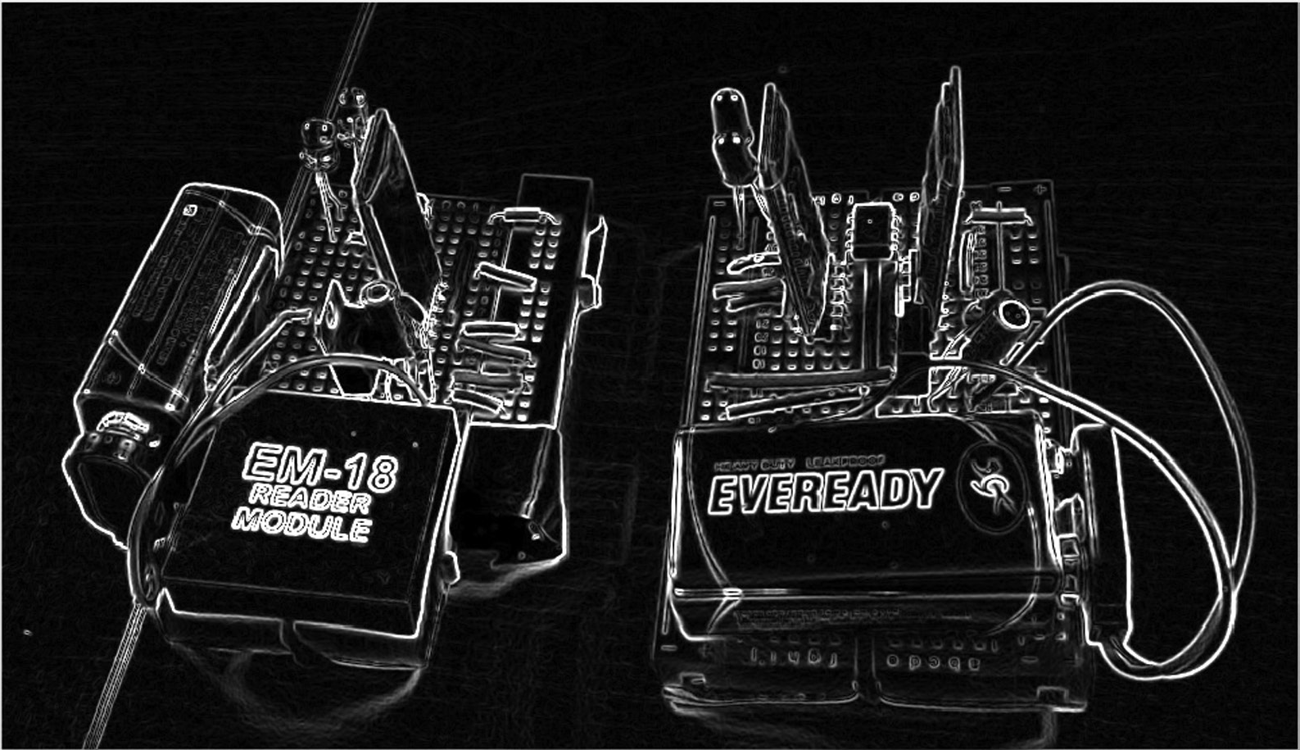
Lecture 7 Edge Detection
ECE 1390/2390

Slide 2
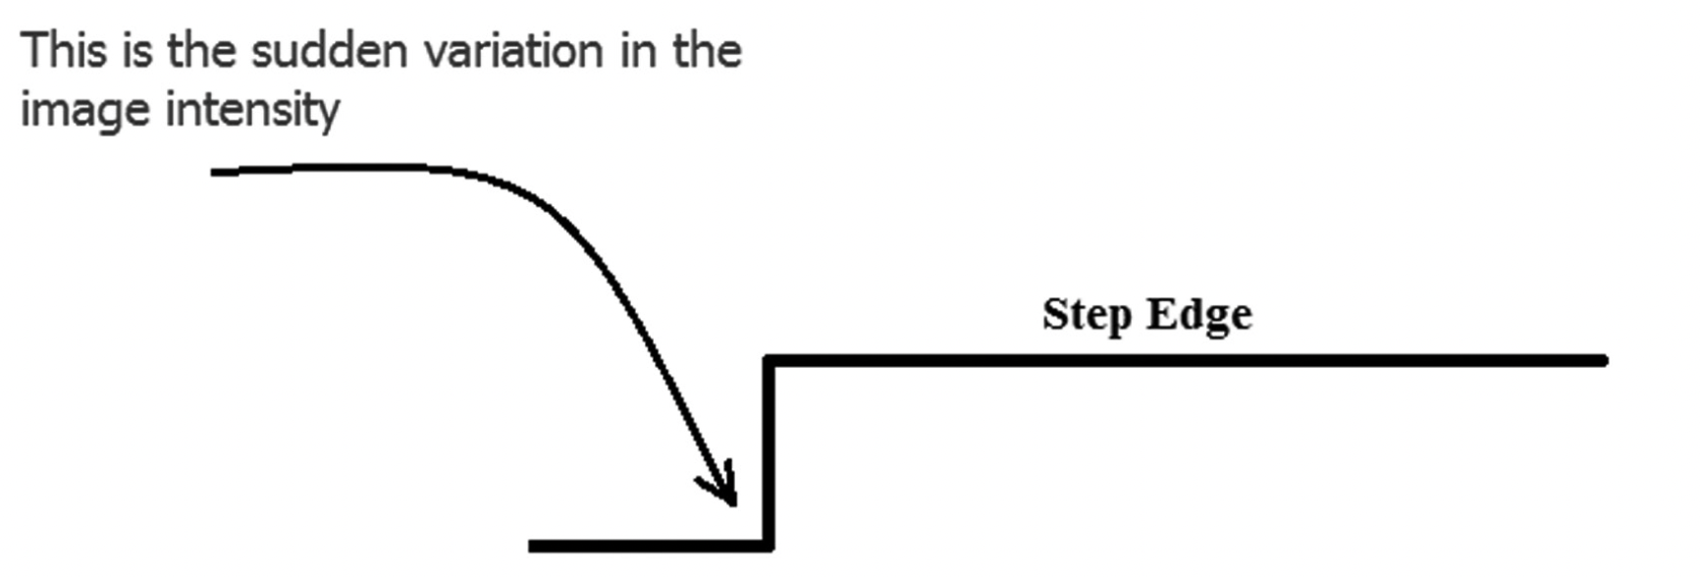
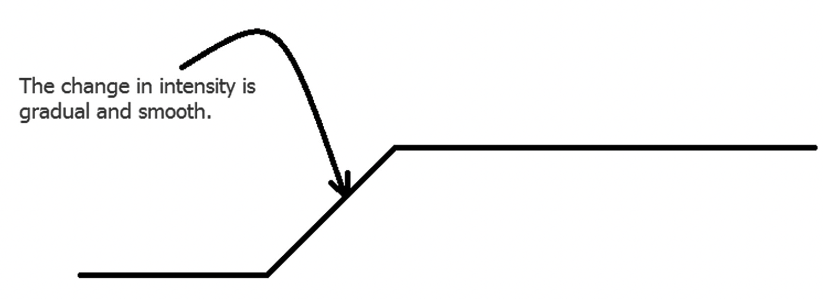
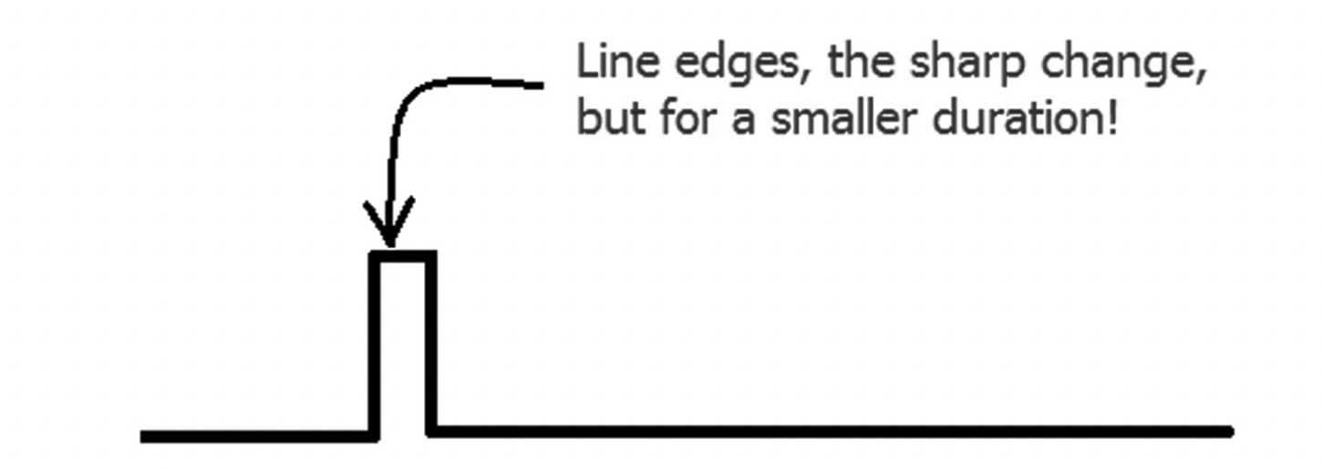
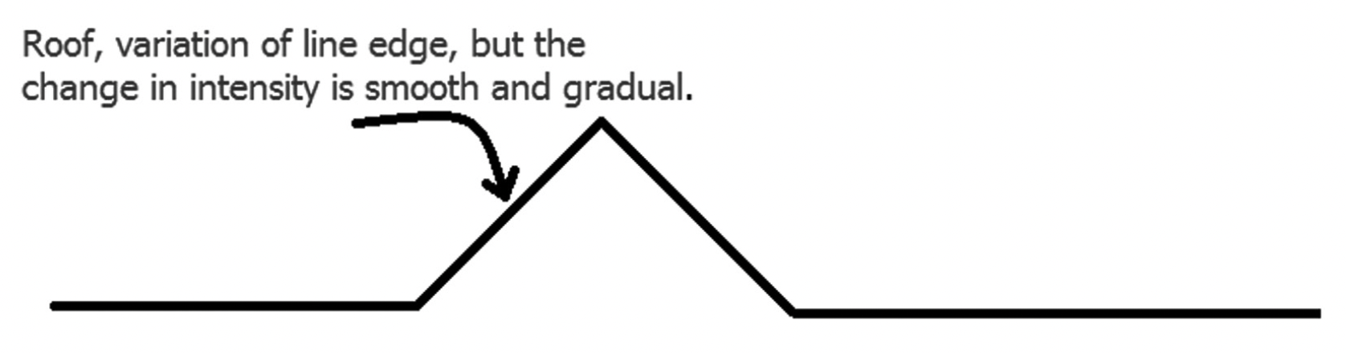
Types of edges

Slide 3
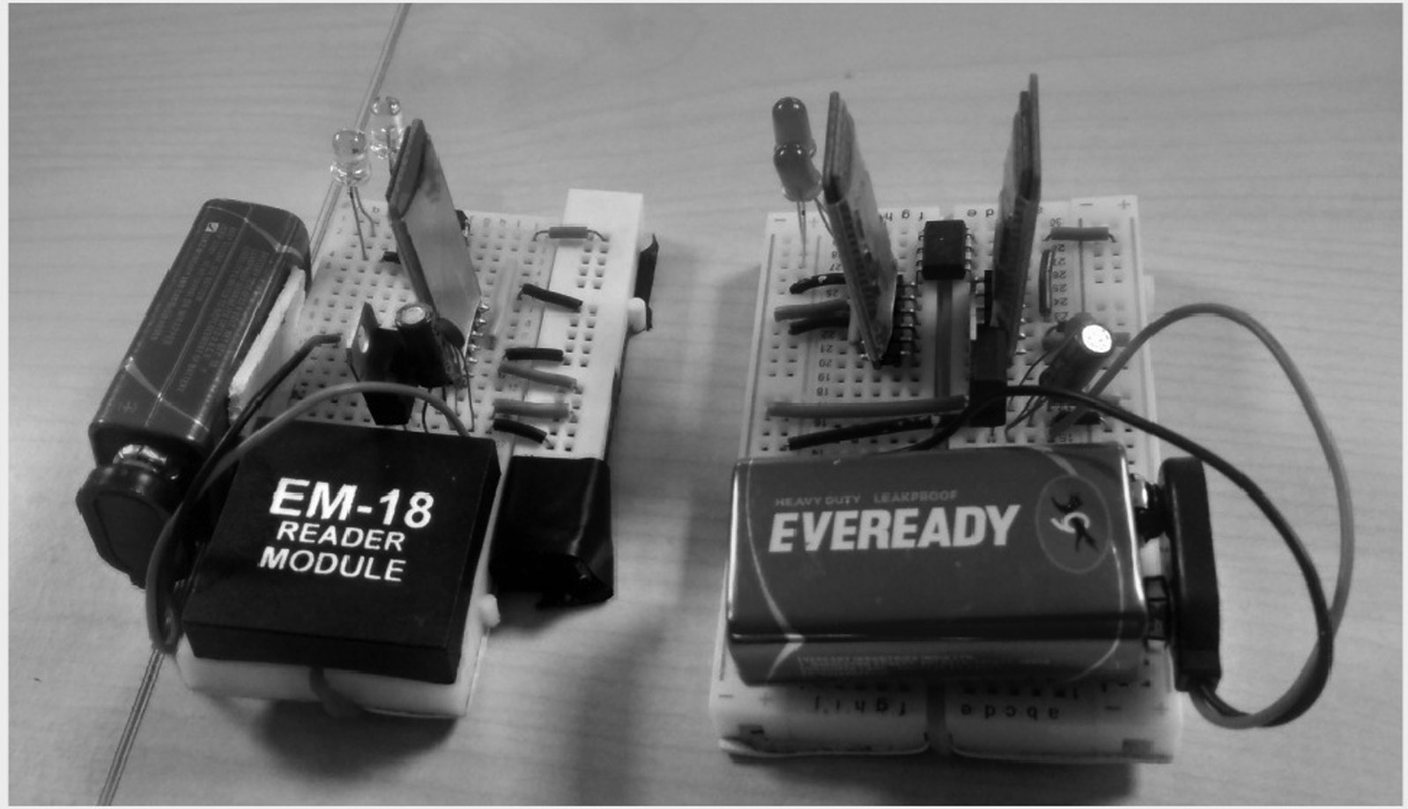
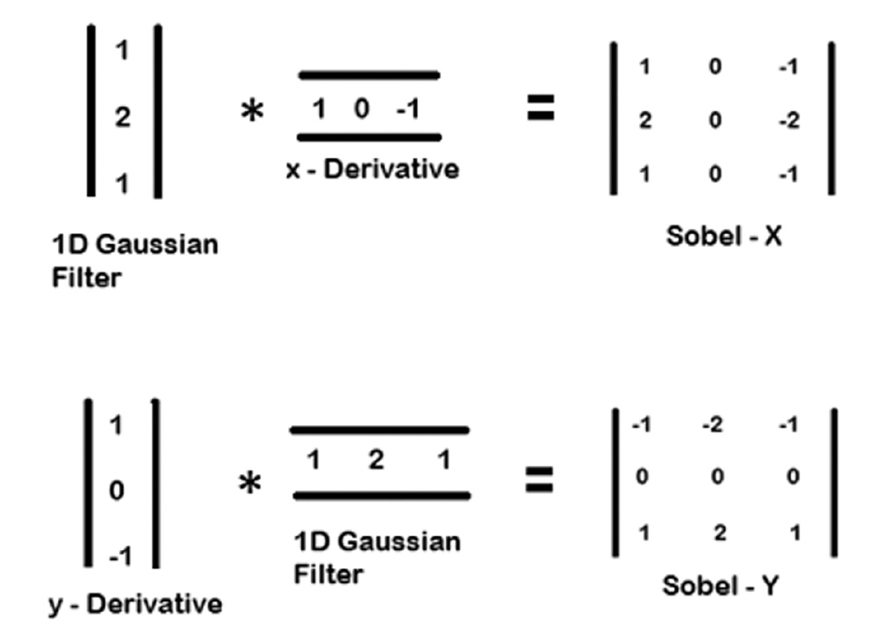
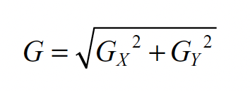
Sobel filter
Low-pass filter
High-pass filter

Slide 4
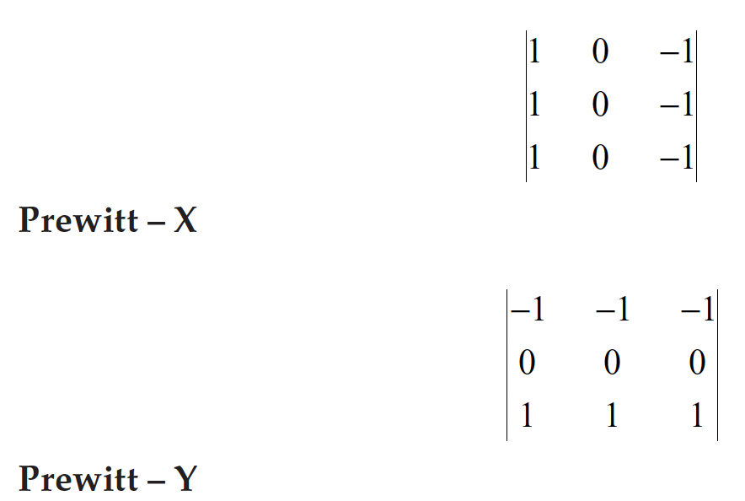
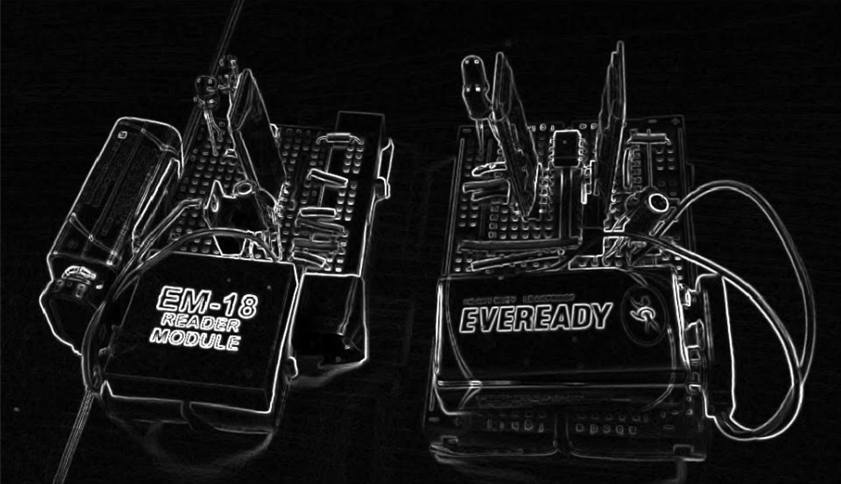
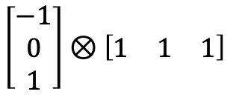
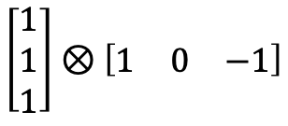
Prewitt filter
Mean smooth filter
High-pass filter
$$\left[\begin{matrix}1 \\ 1 \\ 1\end{matrix}\right]⊗\left[\begin{matrix}1 & 0 & −1\end{matrix}\right]$$
$$\left[\begin{matrix}−1 \\ 0 \\ 1\end{matrix}\right]⊗\left[\begin{matrix}1 & 1 & 1\end{matrix}\right]$$

Slide 5
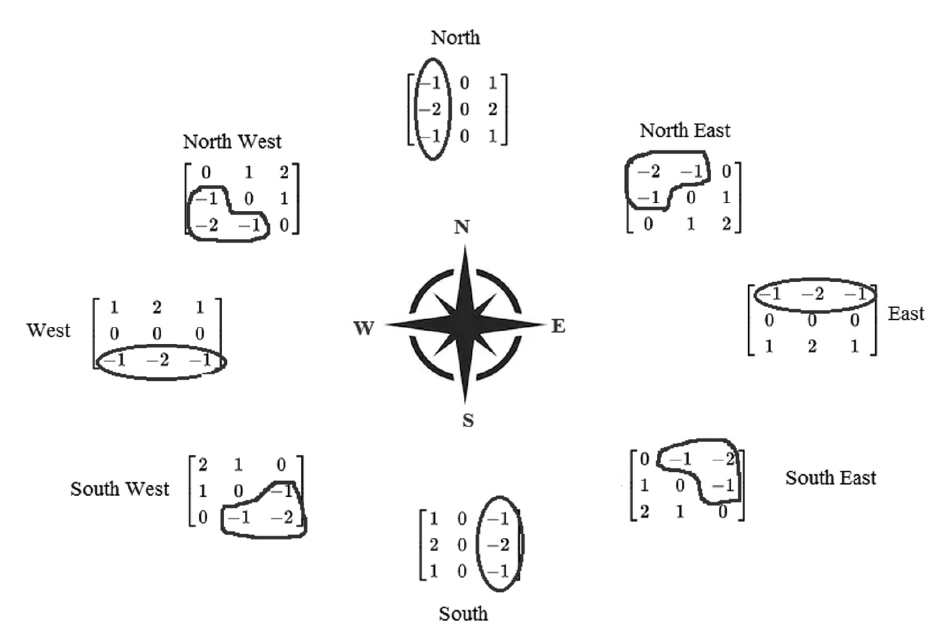
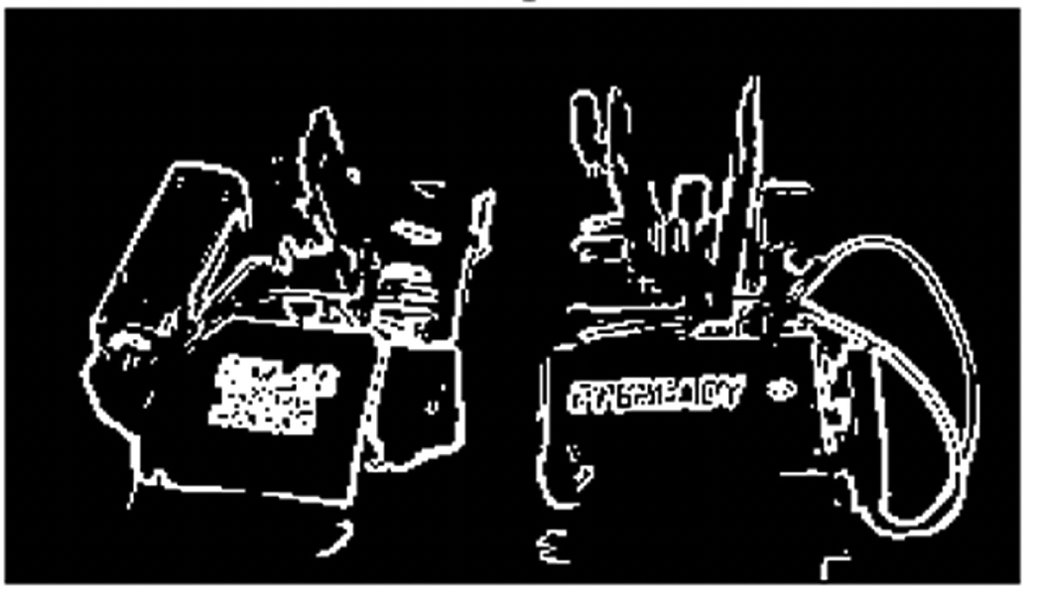
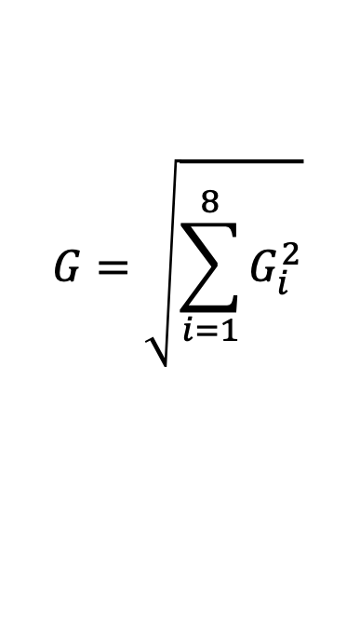
Robinson filter
$$G=\sqrt{\sum_{i=1}^{8}{G_{i}^{2}}}$$

Slide 6
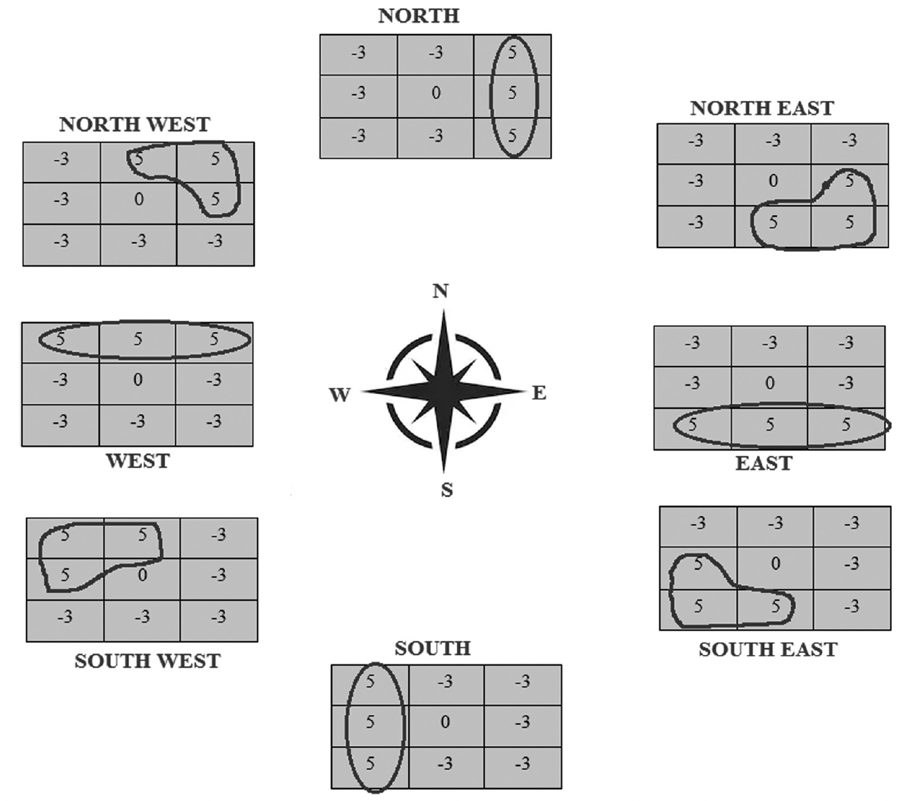
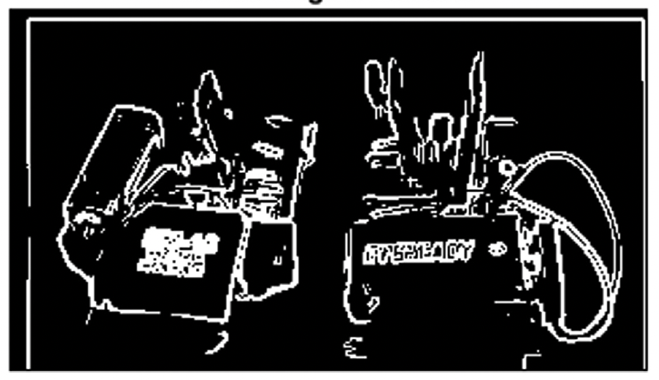
Kirsch Edge Filter
$$G=\sqrt{\sum_{i=1}^{8}{G_{i}^{2}}}$$

Slide 7
Sobel
Prewitt
Small features get enlarged
Robinson
Kirsch

Slide 8
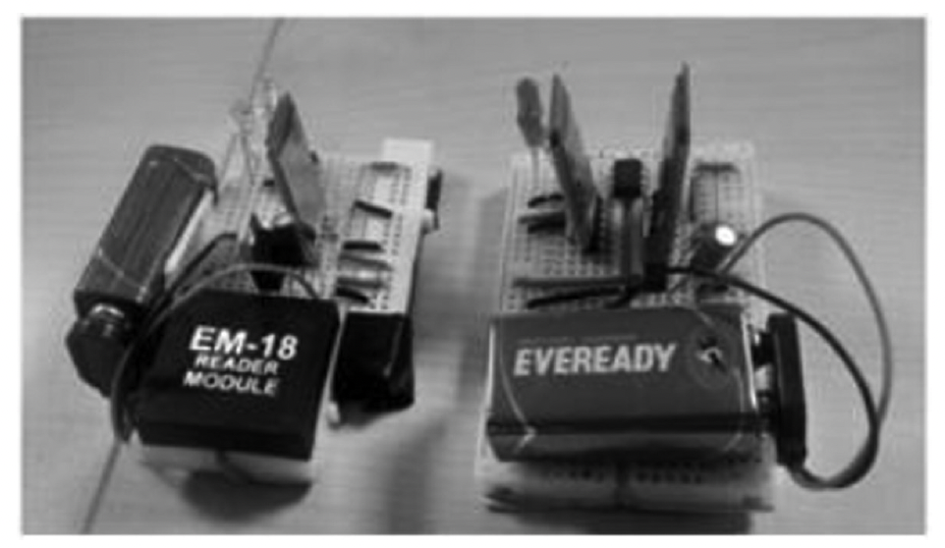
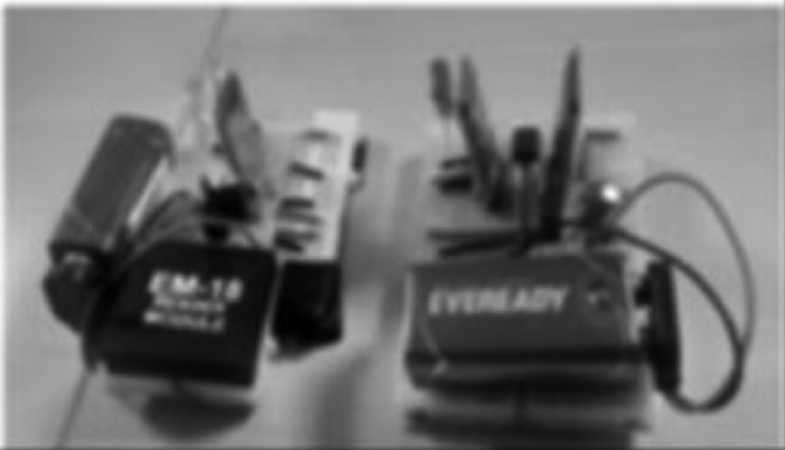
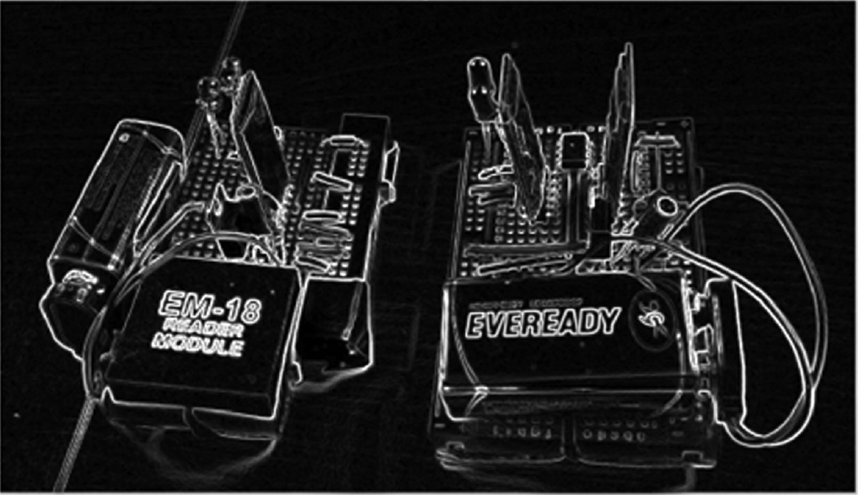
Cany filter
Greyscale image
Gaussian Blur
Sobel filter

Slide 9
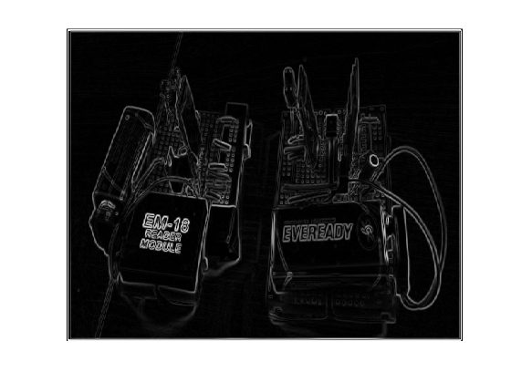
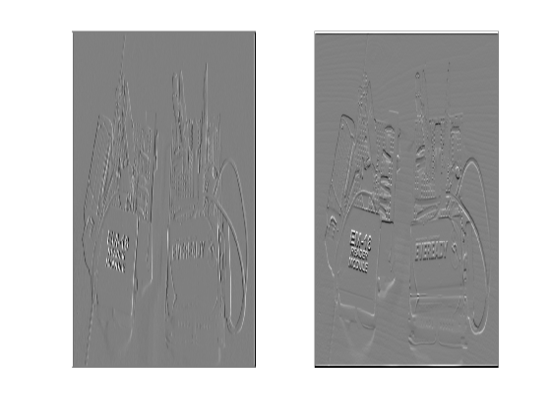
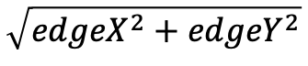
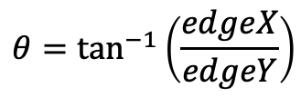
$$\sqrt{{edgeX}^{2}+{edgeY}^{2}}$$
$$θ=\tan^{−1}\left(\frac{edgeX}{edgeY}\right)$$

Slide 10
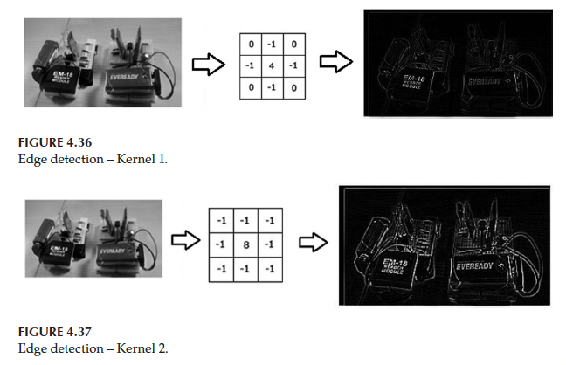
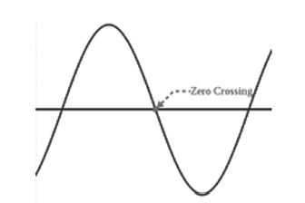
Laplace (2nd derivative)

